Slide 1

FSHARPING #2
Úvod do světa F# (pohledem C# vývojáře)
Roman Provazník
@dzoukr
www.fsharping.cz
@fsharping

Slide 2



Slide 3

F#

Slide 4


Don Syme

Slide 5
Multi-paradigm
Statically typed
OCaml syntax

Slide 6




Slide 7


F#
C#

Slide 8




Slide 9




Slide 10


Slide 11
The Power of F#

Slide 12
Type inference

Slide 13


Slide 14
Immutability

Slide 15
Immutability is overrated,
but no one will change it

Slide 16
Easy to test

Slide 17
Hard to screw

Slide 18
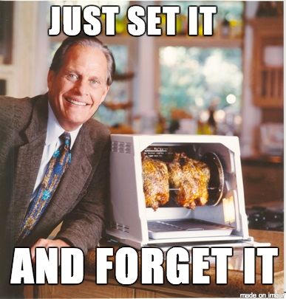

Slide 19
No NULL

Slide 20
Say it again!

Slide 21
No

Slide 22
NULL

Slide 23
Clean code

Slide 24
C#
{{{{{{{{;;;code;;;; }}}}}}}}

Slide 25
F#
code

Slide 26
Less code = Less noise

Slide 27
Less code = Less names

Slide 28
StatelessDataSourceRollbackFactory
AbstractDefaultJavaModelProxy
InternalNamespaceSelectionSingleton

Slide 29
189 projects in solution
9350+ classes
1140 TODOs in code

Slide 30


Slide 31
Naming is HARD

Slide 32
The length of a name should be related to the length of scope

Slide 33
Anonymous functions

Slide 34

Combine all paradigms!

Slide 35
OOP + FP = faster learn

Slide 36
REPL

Slide 37
Read-Evaluate-Print Loop

Slide 38
Use debugger only for bugs

Slide 39
Faster development

Slide 40


Slide 41
$$$

Slide 42
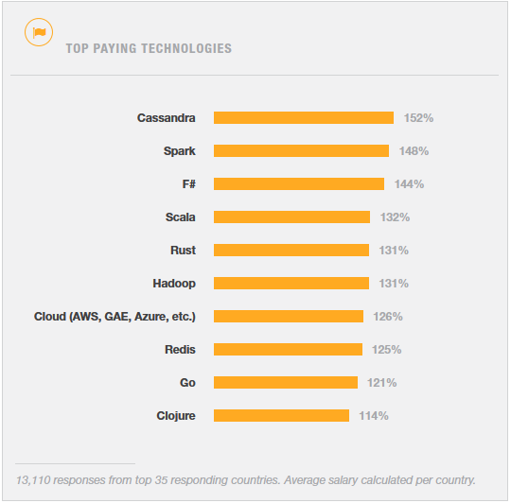
http://stackoverflow.com/research/developer-survey-2015

Slide 43
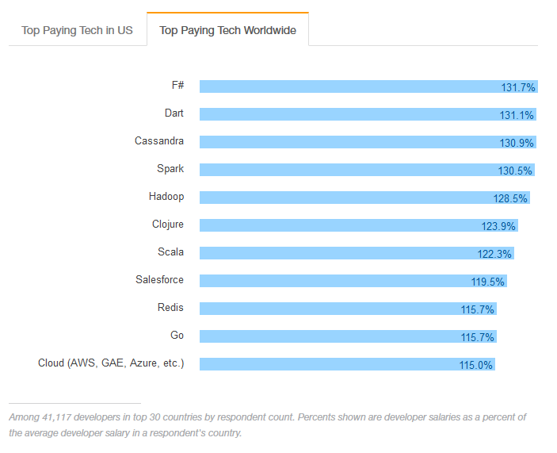
http://stackoverflow.com/research/developer-survey-2016#technology-top-paying-tech

Slide 44
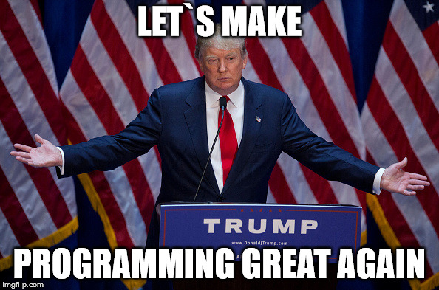

Slide 45
Let`s start with F#

Slide 46
.fs vs .fsx

Slide 47
module vs namespace

Slide 48

Babica rule

Slide 49

If you don`t know, use module

Slide 50
DEMO #1 Simple function

Slide 51

F# cool features

Slide 52
Tuple

Slide 53
Data structure with N elements

Slide 54
Ideal as lightweight function return value

Slide 55
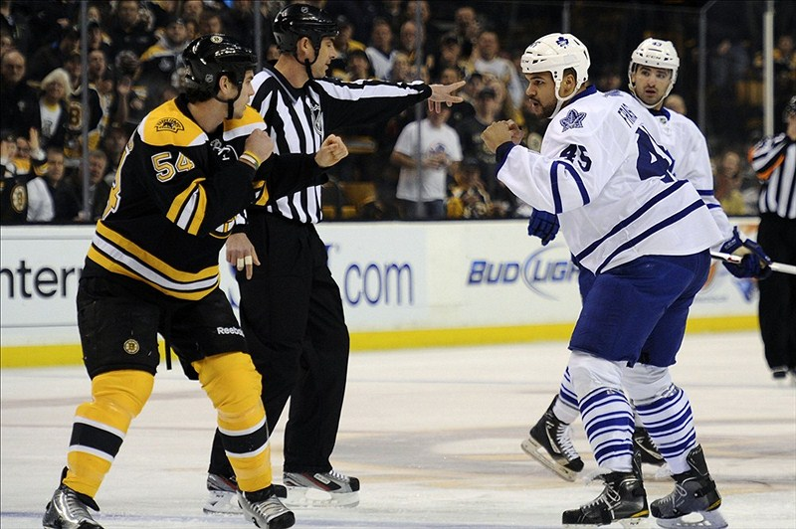

Slide 56
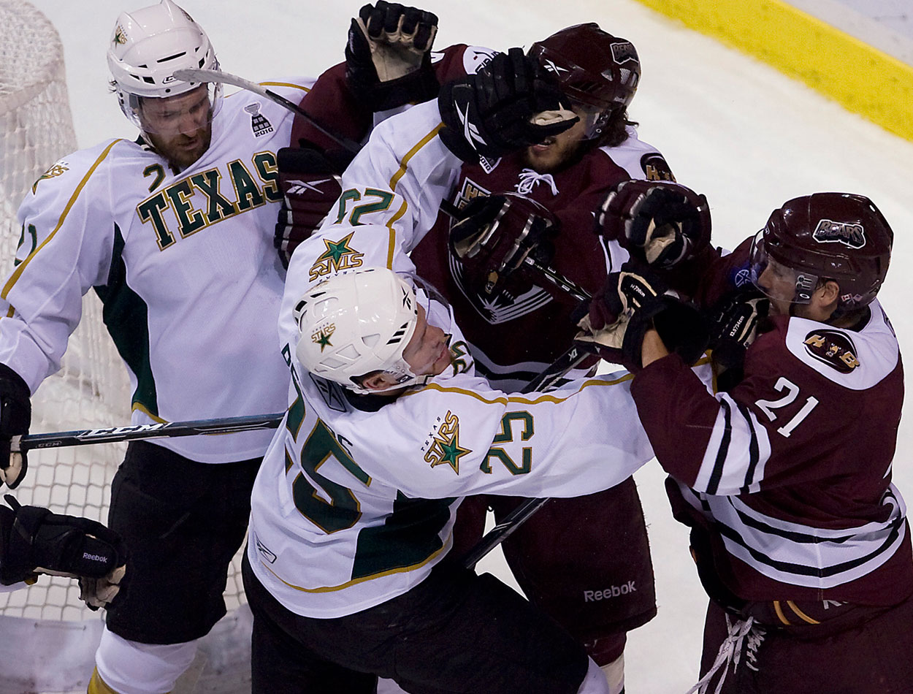

Slide 57
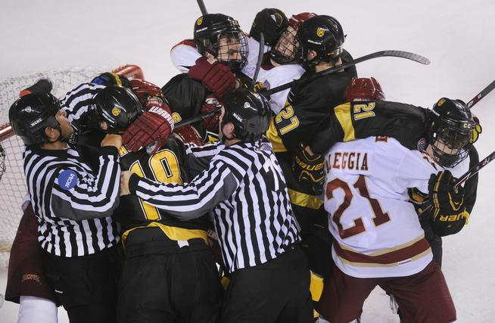

Slide 58
DEMO #2 Tuples

Slide 59
Lists

Slide 60
F# list <> .NET List class

Slide 61
Immutable by default

Slide 62
Essential type for FP

Slide 63
DEMO #3 Lists

Slide 64
Functions

Slide 65
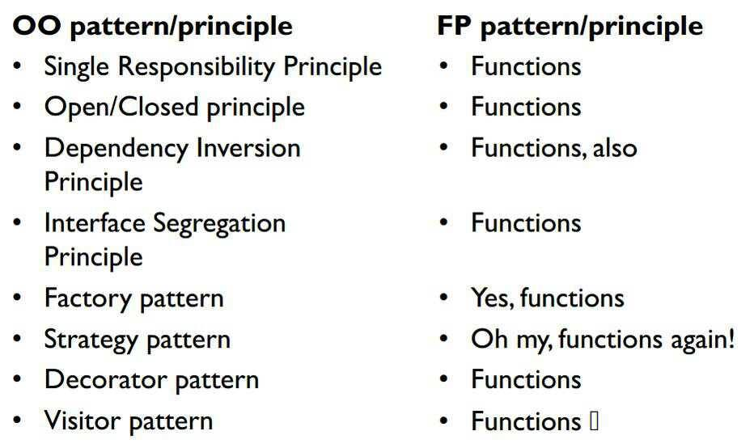
http://blog.cleancoder.com/uncle-bob/2014/11/24/FPvsOO.html

Slide 66
DEMO #4 Functions

Slide 67
Option

Slide 68
Do you remember NULL?

Slide 69


Slide 70
Use Option

Slide 71
Some(value)

Slide 72
None

Slide 73
Nothing else

Slide 74
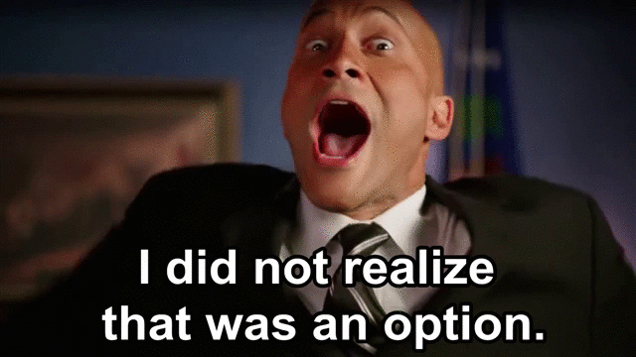

Slide 75
DEMO #5 Options

Slide 76
Pattern Matching

Slide 77
Best. Thing. Ever.

Slide 78
SWITCH (on heavy drugs)

Slide 79
Is everywhere in F#

Slide 80
DEMO #6 Pattern Matching

Slide 81
Discriminated Unions

Slide 82
Another essential type

Slide 83
Pattern Matching Support

Slide 84
Enum (on even heavier drugs)

Slide 85
Value that can be exactly one case

Slide 86
DEMO #7 Discriminated Unions

Slide 87
Records

Slide 88
Great for grouping data into structured format

Slide 89
Immutable by default

Slide 90
But easy to clone

Slide 91
Cannot be inherited

Slide 92
Structural comparison and equality

Slide 93
Pattern Matching Support

Slide 94
“.” notation access

Slide 95
DEMO #8 Records

Slide 96
Unit

Slide 97
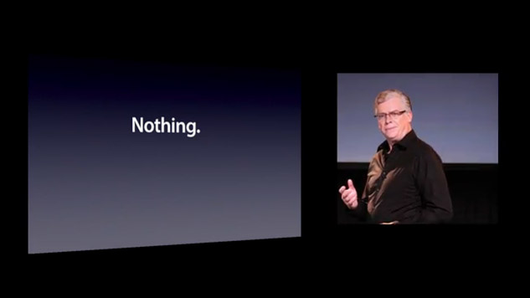

Slide 98
()

Slide 99
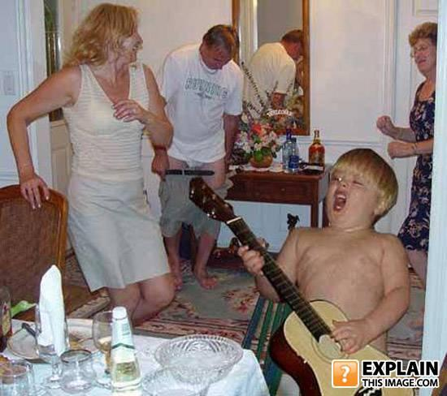
Even cooler features

Slide 100
Operators

Slide 101
|>

Slide 102
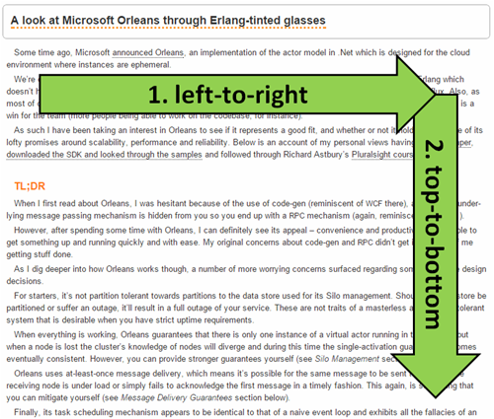
http://theburningmonk.com/2014/12/being-visually-honest-with-f/

Slide 103
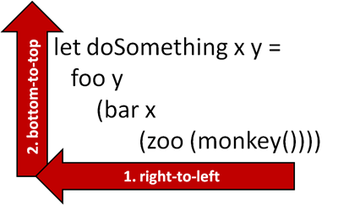
http://theburningmonk.com/2014/12/being-visually-honest-with-f/

Slide 104
|>

Slide 105
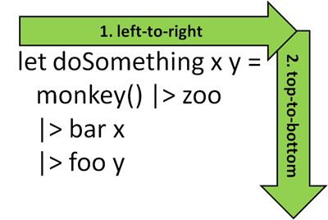
http://theburningmonk.com/2014/12/being-visually-honest-with-f/

Slide 106
<|

Slide 107
Function composition

Slide 108
>>

Slide 109
f(a) -> b >> f(b) -> c

Slide 110
f(a) -> c

Slide 111
<<

Slide 112
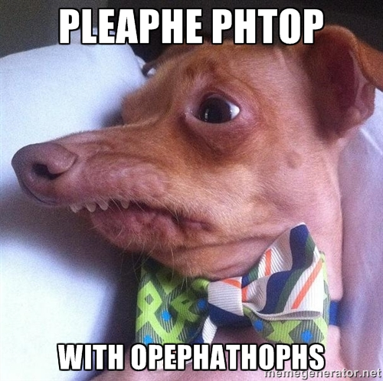

Slide 113
DEMO #9 Operators

Slide 114
Partial Function Application

Slide 115
Don`t use tuples as input parameters

Slide 116
Currying

Slide 117
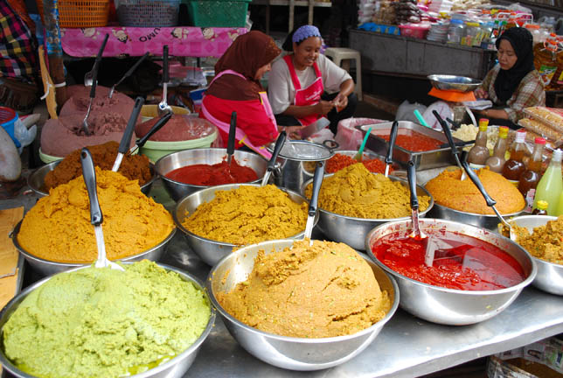

Slide 118
Transformation of function with N parameters into chain of N functions with 1 parameter

Slide 119
DEMO #10 Partial Function Application

Slide 120
Summary

Slide 121
F# is COOL!

Slide 122
Pattern Matching
Type inference
Immutability
Operators
Functions
Records
Discriminated Unions
no NULL

Slide 123
…and much more!

Slide 124

Thank you!

Slide 125
Please fill in
fsharping.cz/feedback
Úvod do světa F# (pohledem C# vývojáře)
Roman Provazník
@dzoukr
www.fsharping.cz
@fsharping

